Slide 1

Random Slopes Models in R
Psych 741: Hierarchical Linear Modeling

Slide 2
Overview of Tutorial Slides
Random Slopes Multilevel Models
Overview of tutorial data (page 4)
Example Model, Code, and Output for a null model, random intercept model, and random slope model (pages 5-10)
Random effect p values and likelihood ratio tests (pages 11-12)
Example Unstructured Covariance Model and Output (pages 13-14)

Slide 3
Random Slopes Models

Slide 4
Tutorial Data
Using the lq2002.sav data file on Canvas
Sample of individual army members nested in army companies
Example from the Garson textbook
The following variables are included in the data set:
HOSTILE: Individual-level Hostility Scale score
TSIG: Individual-level Task Significance score
LEAD: Individual-level perceived task leadership climate
COMPID: Grouping variable
GTSIG: Company-level aggregate Task Significance score

Slide 5
Example Model and Code
Imagine the following research question:
“What is the effect of individual-level and company-level perception of task significance, and individual perceived task leadership climate, on mean individual-level feelings of hostility, adjusting for the clustering of hostility scale scores and the clustering of the effect of perception of task significance by army company?”

Slide 6

Example Model and Code
First, let’s perform a null multilevel model for subsequent comparison:
HOSTILE: the DV.
(1|COMPID): the random intercept.
REML = FALSE: the default in lmer() is to use restricted ML. Need to set this to false if you want to use ML.
lq2002: the dataframe name.

Slide 7
Example Model and Code
Second, let’s perform a random intercept model for subsequent model comparisons as well:
Same as the null model, but with the following three additions:
TSIG: the Level 1 predictor of individual ratings of task significance.
GTSIG: the Level 2 predictor of company-level (average) ratings of task significance.
LEAD: the Level 1 predictor of individual ratings of task leadership.

Slide 8
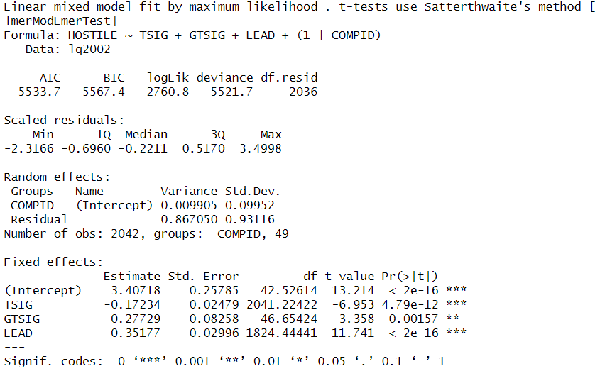
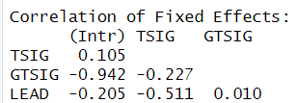
Example Output for the Random Intercept Model

Slide 9
Example Model and Code
Finally, let’s perform a random slopes model to test the complete hypothesized model:
Same as the random intercept model, but with the following addition:
(1|COMPID:TSIG): the random slope parameter for the effect of TSIG.

Slide 10
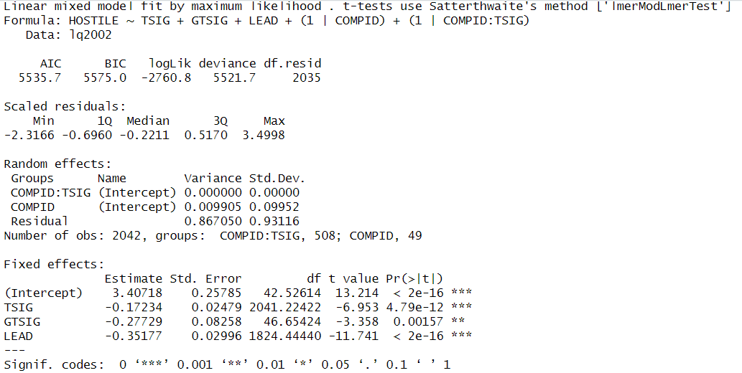
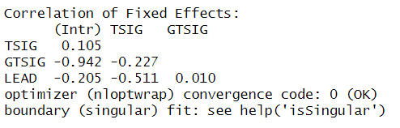
Example Output for the Random Slope Model

Slide 11
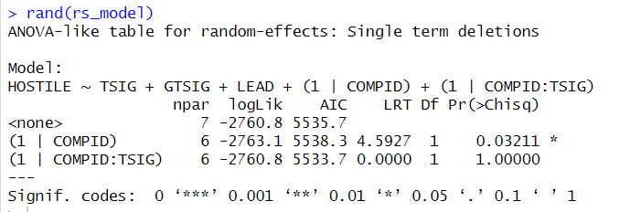
Getting p-values for random effects
Use the rand() function from the lmerTest package

Slide 12
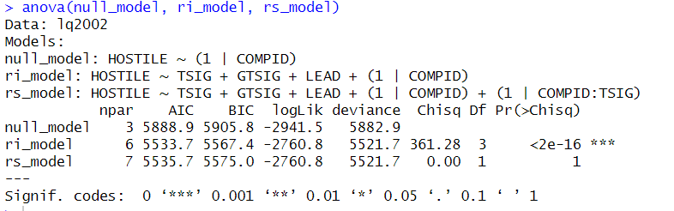
Likelihood ratio test
Use the anova() function to compare the null, random intercept, and random slopes models

Slide 13
Example Unstructured Covariance Model
What if we wanted to perform a model that allowed the two random effects to correlate with one another?
Same as the random slopes model before, but with the following modification:
(1 + TSIG|COMPID): the random intercept and slope parameter for the effect of TSIG are together within a single parenthesis.

Slide 14
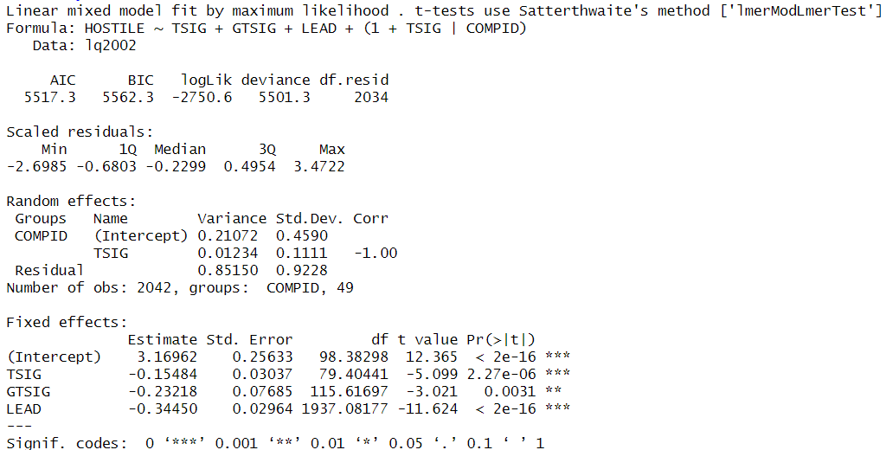
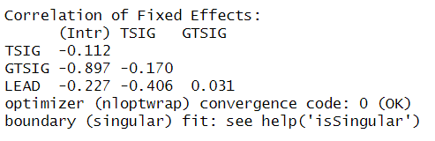
Example Output for the Unstructured Covariance Model

